Slide 1

Track My Track
Elisha Parslow
Maddy Cook

Slide 2
The Project
Android app designed for high school track athletes
The athlete can:
Create, build, and edit a profile
Store meet, practice, and overall records
Use the stopwatch and timer
Go to the settings
Add featured icons to the menu

Slide 3
Background of the Idea
We are both runners
Track is pretty cool.. And interesting (if you like track)
Our High school track experiences have shown us:
Meet scores matter more than collegiate
Records are kept by athletes more readily
HS Athletes desire more access to athlete stats and information

Slide 4
Individual Contributions
Maddy
Elisha
Creating wireframes, layouts, and design
Connecting to Azure and using SQL
PHP calls between the database and App
Moving project from Android Studio to Xamarin –Visual Studio
Implementing buttons
Connecting layouts to source code pages
Stopwatch functionality
Interface visuals -> drawables

Slide 5
Challenges
Xamarin -> Android Studio -> Xamarin on Visual Studio
Deciding which platform was the best for developing an android app
Android Studio missing many backend components to run apps
From learning Java to learning C#
Button clicking and connecting layout pages to source code pages
Differences in code for Java and C#
Connecting to Azure and activating the database using SQL
Using the internet for help with Xamarin: very small community

Slide 6
Successes
Moving the project to Xamarin on Visual Studio
Project functionality and emulator success
Easy move to transfer wireframes (.xml to .axml in visual studio)
C# has many similarities with C++
Setting up the database to require user login
SQL and Azure connections
Useful for later user profile development
Basic app functionality
Move from one layout to another -> button clicks
Profile details
Stopwatch
User interface
Visually appealing and easy to follow

Slide 7
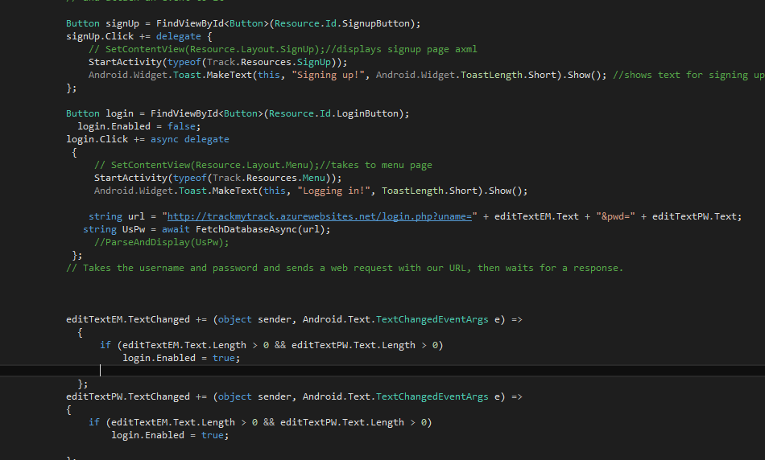
Behind the scenes –Login Page [Database]

Slide 8
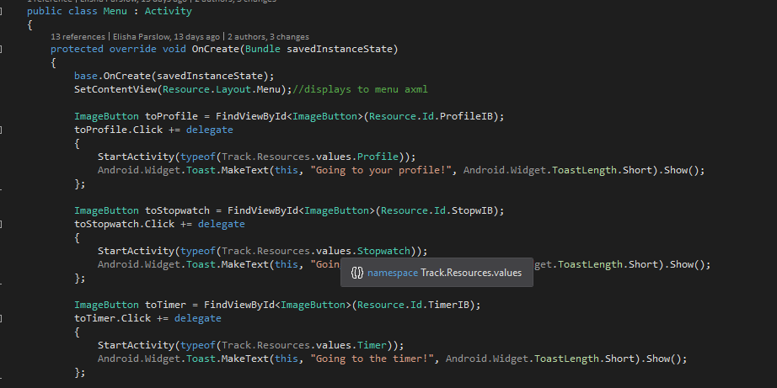
Behind the scenes –Menu Page [Buttons]

Slide 9
Track My Track 2.0 [future development]
Implement a split calculator
Allow athlete to use add on, records, and settings functions
Connect to athletic.net to upload athlete’s times w/o them inputting the times themselves
Connect to server with all of the high school athlete meets in the country and allow the user to connect to that meet
Access meet schedule
Warm –up alerts
Live results

Slide 10
LET’S DEMO!

